Slide 1
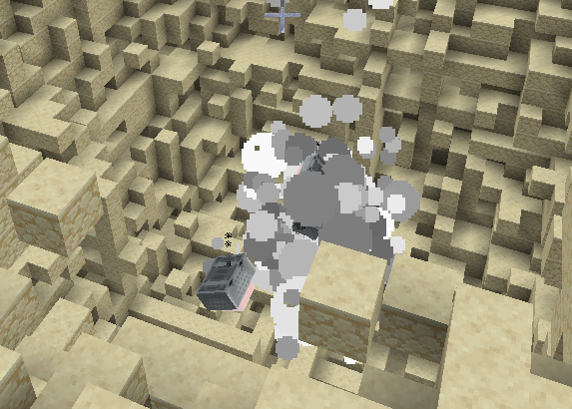
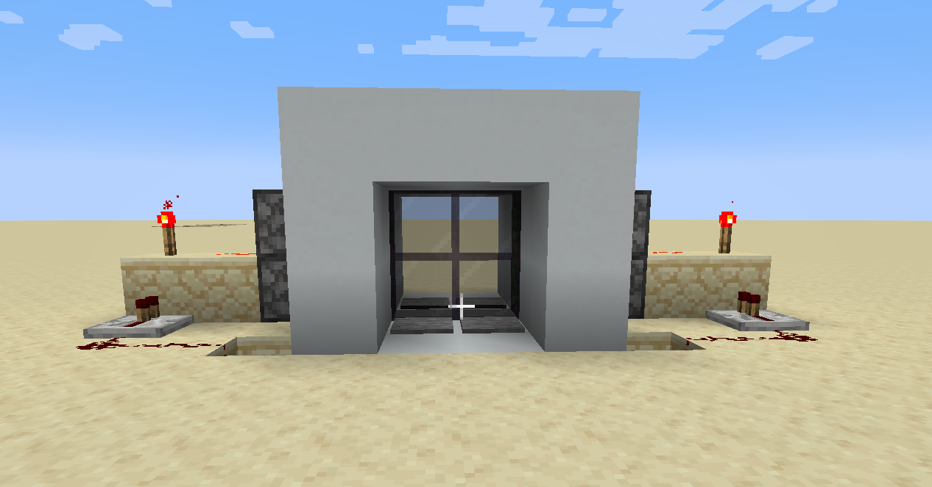
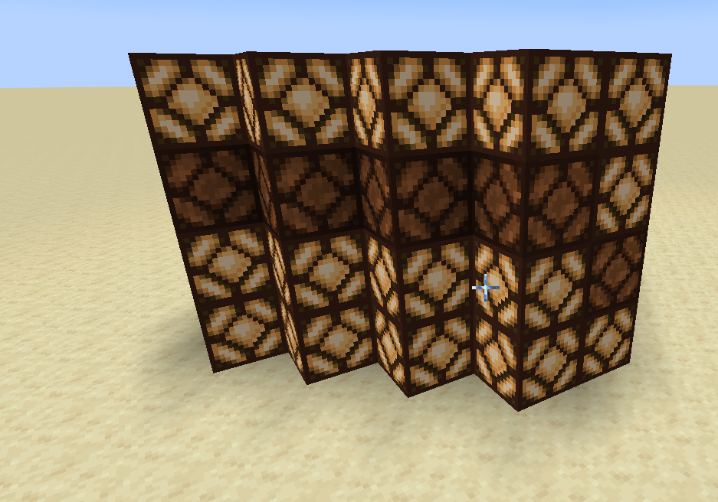
Redstone Creations I
Kael Rodine’s
Minecraft Mastery: Redstone Realms
Sliding glass door – Medium
Simple sound bomb – Easy
Everwalking TNT Minecart – Easy
Observer Light Tower – Medium
Bread Baker - Complex

Slide 2
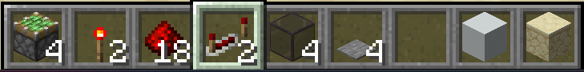
Sliding glass door – medium
Materials needed: sticky piston, redstone torch, redstone dust,
Redstone repeater, glass(any), pressure plate(any), building blocks(any)

Slide 3
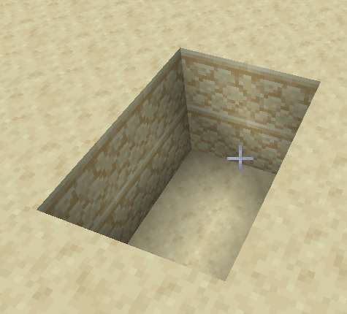
Step I
Dig a hole 2 deep, 2 wide, and 3 long

Slide 4
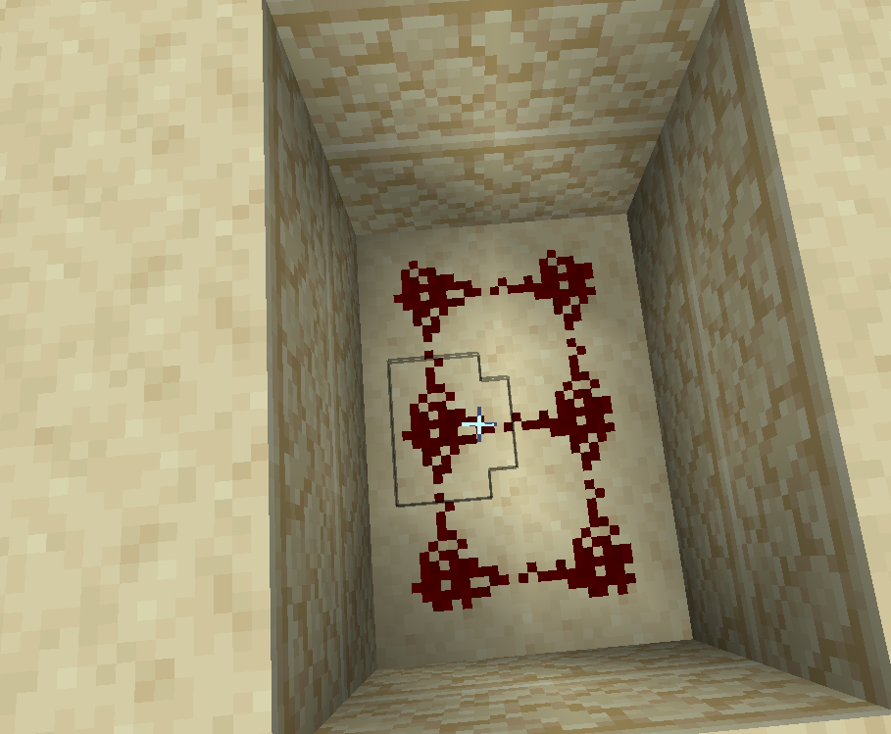
Step II
Place Redstone dust on the bottom, as shown

Slide 5
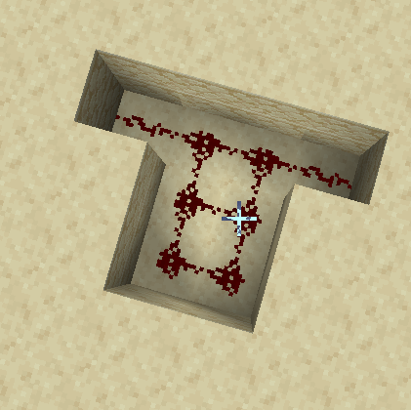
Step III
On one side, dig 2 more 2-deep holes and place redstone dust on the bottom of both

Slide 6
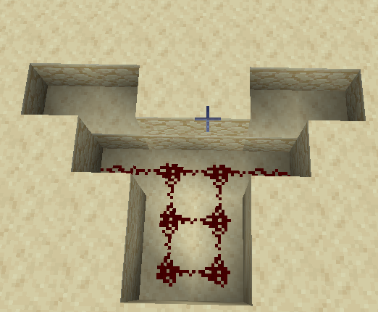
Step IV
Dig 1-deep holes is the places on screen

Slide 7
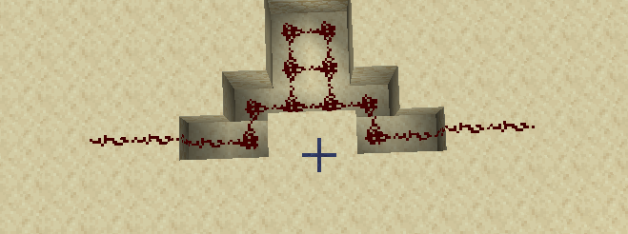
Step V
Place 4 redstone dust on each side, like in the picture

Slide 8
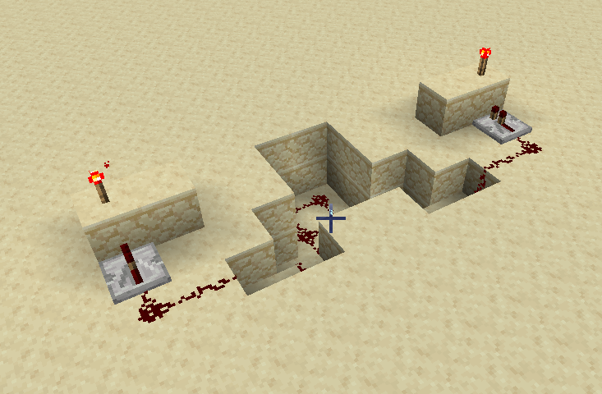
Step VI
On both sides, add a repeater (on 1 tick) facing a solid block of your choice
Then place a redstone torch on top of that block
Then place a solid block on the side of the first
Do this on both sides!

Slide 9
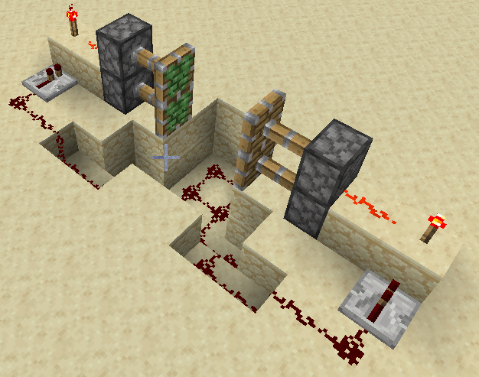
Step VII
Place redstone dust and sticky pistons in the locations shown, if done properly, the pistons should extend

Slide 10
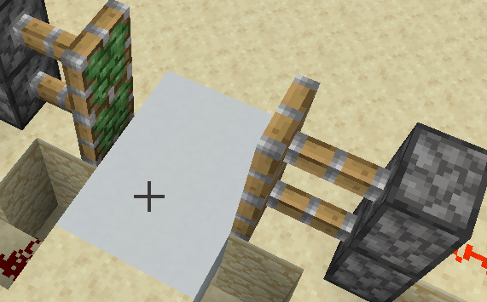
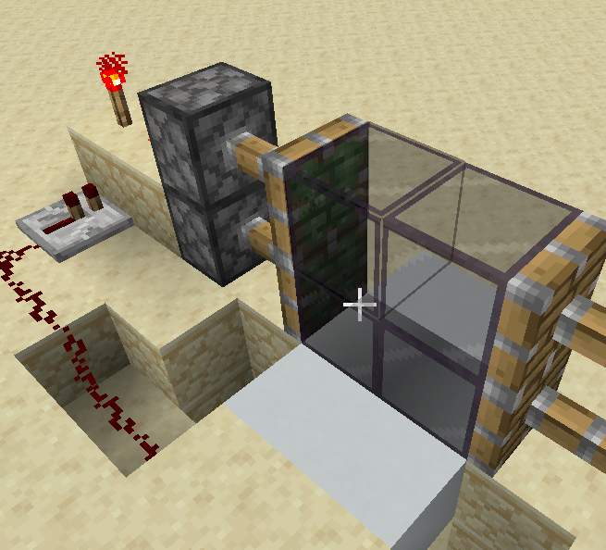
Step VIII
Place the floor block of your choice on top of the middle six redstone and then put the four door blocks of choice into place.

Slide 11
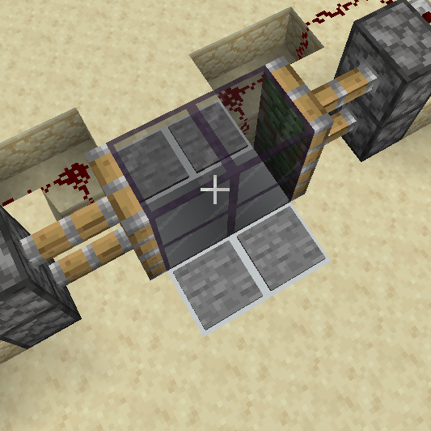
Step IX
Place the four pressure plates of choice into the positions shown
You should be done after this, when covering it up, make sure to leave the redstone connected, or it might break the door

Slide 12
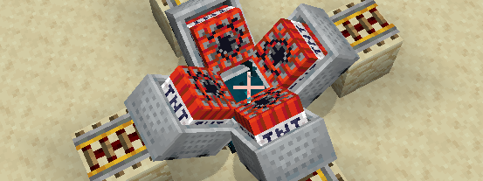
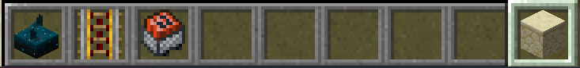
Simple sound bomb - easy
Materials needed: sculk sensor, powered rails, tnt minecart, building block of choice

Slide 13
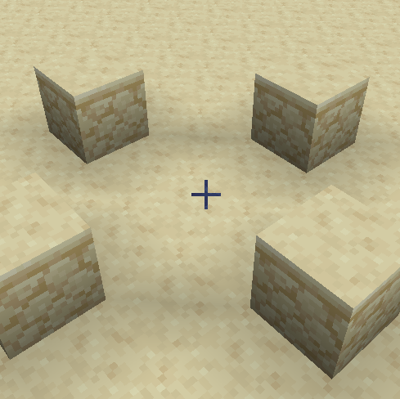
Step I
Imaginary block
Place 4 of any block(preferably weak to blasts, but do try obsidian sometime as I feel it leaves interesting results) 2 blocks away from a center block of choice

Slide 14
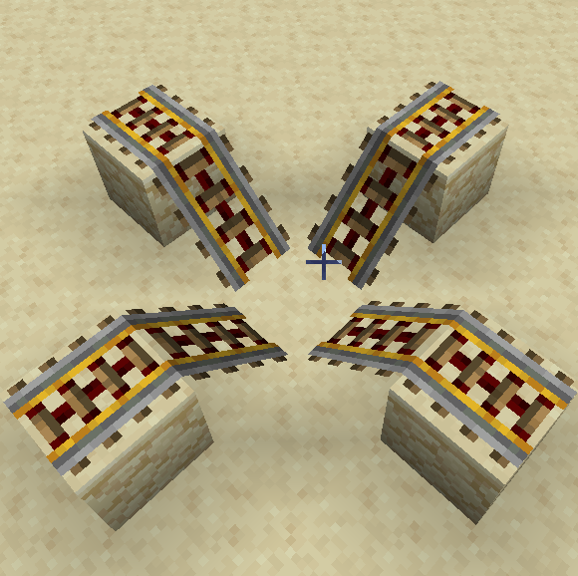
Step II
Place powered rails in the places shown, facing toward the same central imaginary block

Slide 15
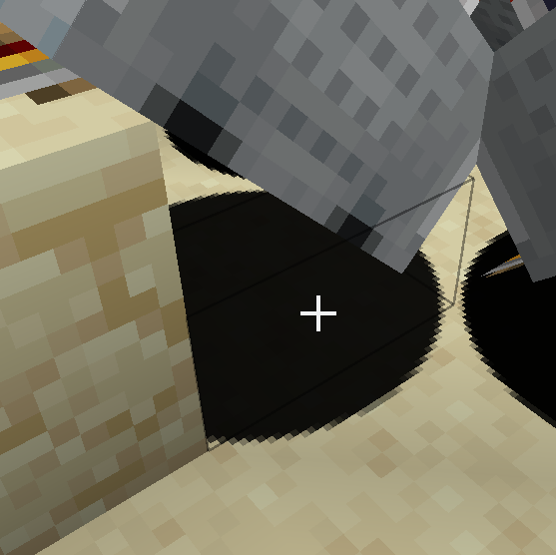
Step III
Repeat the following on all 4 diagonal rails:
Right click the little grey hitbox (shown in the image) with a TNT minecart as much as you want! The more TNT minecarts you place, the bigger the explosion!
Don’t bump the minecarts!

Slide 16
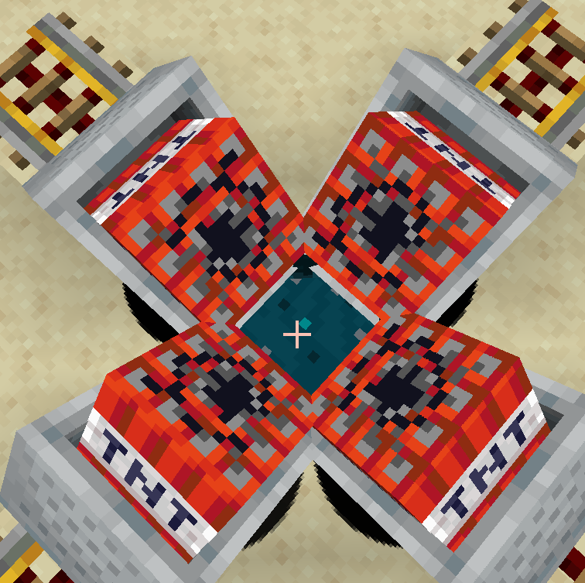
Step IV
When you are done carefully place a sculk sensor in the center of the build
Don’t bump the minecarts!
You are done! If you make any noise near this thing, it will explode suddenly!

Slide 17
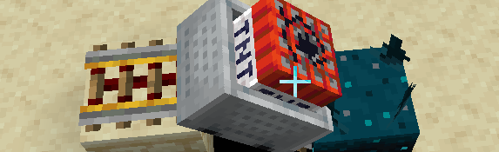
The everwalking TNT minecart - easy
All you have to do is build the Simple sound bomb but only do one of the four powered rail tracks and TNT minecart stacks!

Slide 18
Observer light tower - medium
Materials needed: observer, redstone lamp

Slide 19
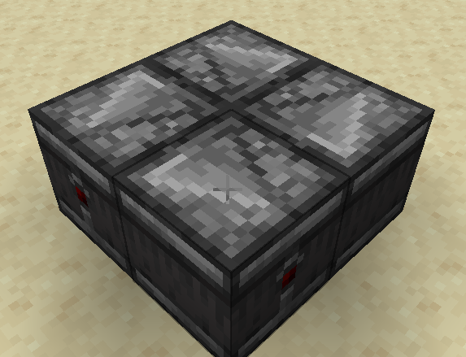
Step I
Have four observers, each one facing the next in a never-ending loop known as an observer clock

Slide 20
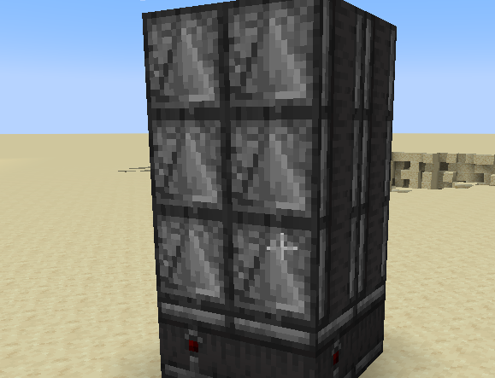
Step II
On top of the observer clock, place 4 lines of observers facing downward(looking downward), you can make these as tall (height limit) or as small(0) as you want!

Slide 21
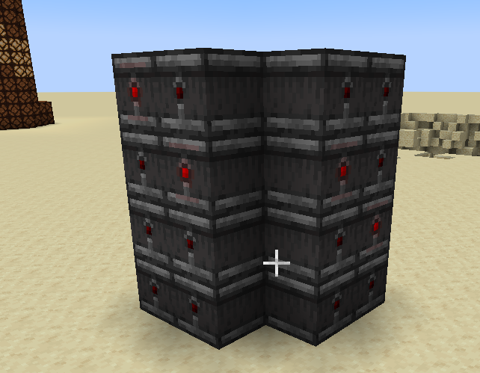
Step III
On each of the four sides, place observers facing the central pile of observers, if done correctly, the dots on the backs of the observers should constantly flash red!

Slide 22
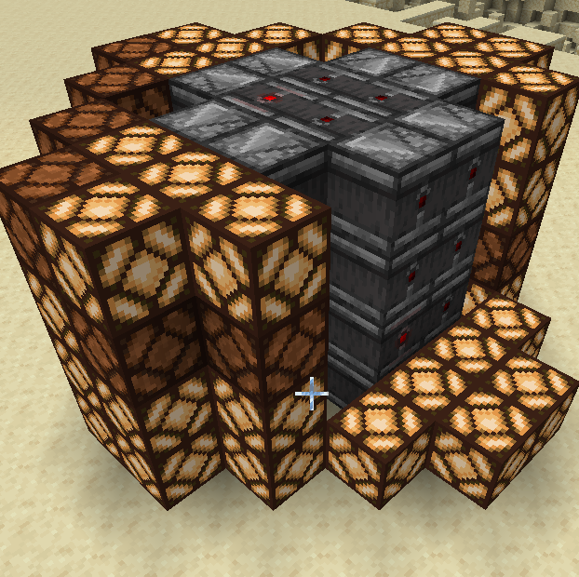
Step IV
Place redstone lamps as shown (covering up the side I left blank)
Done!

Slide 23
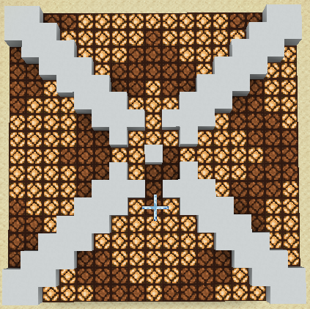
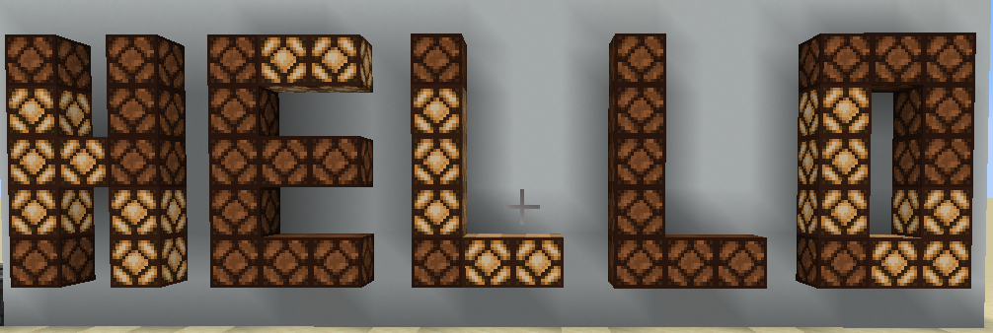
Observer light fixtures+
Can anyone take a guess at how these were made?

Slide 24
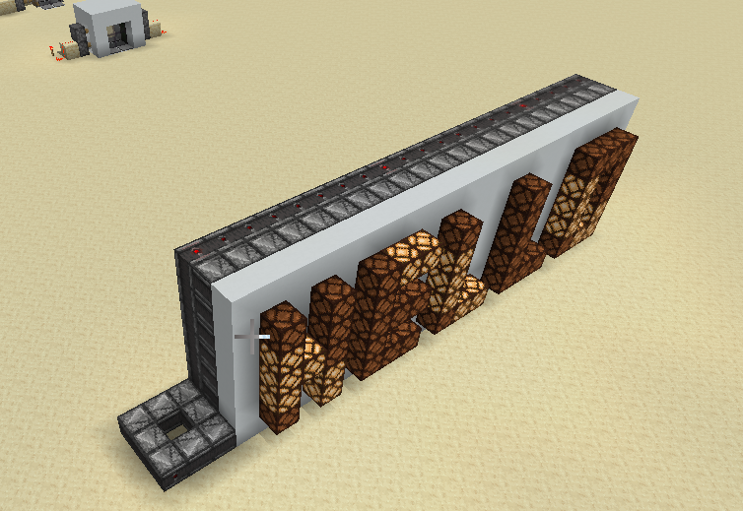
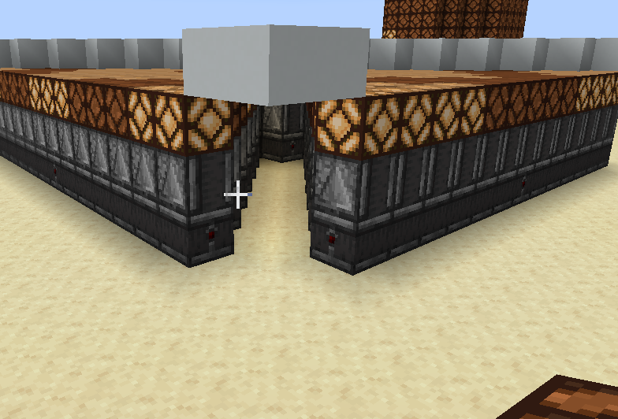
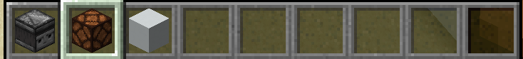
answer
These 3 simple materials! It just needs an observer clock and a way to bring the power to the redstone lamps!

Slide 25
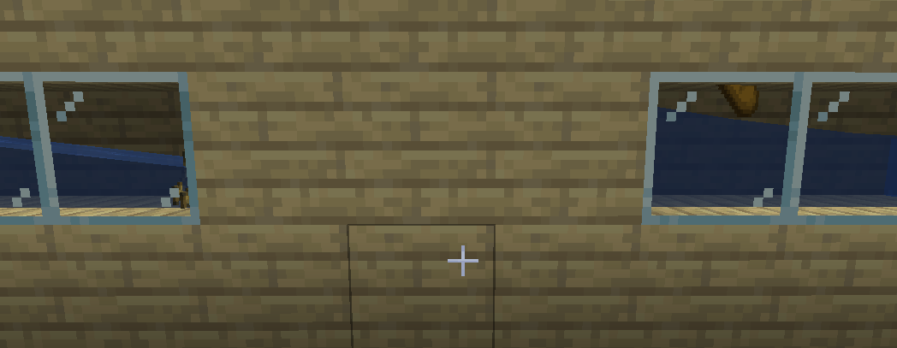
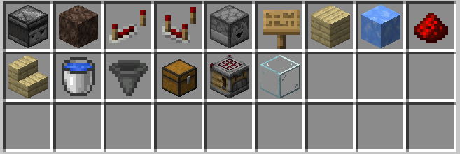
Bread Baker - Complex
Very complicated, be sure to ask for help if you need it
Pink wool is a temporary block used to show distance
Materials(in order shown above): observer, soul sand, repeater, comparator, dropper, sign(any), building block(any), blue ice, redstone dust, stair(any), water bucket, hopper, chest, crafter, glass(any)

Slide 26
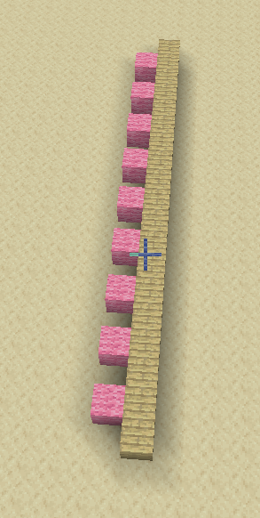
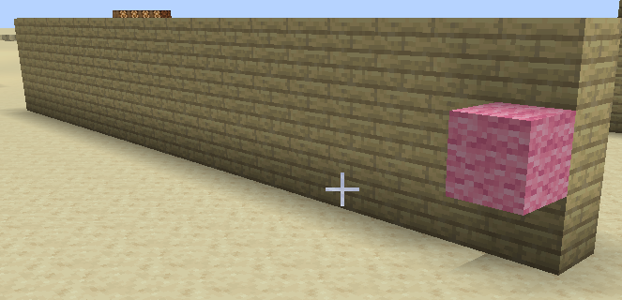
Step I
Make a 19 long line of blocks, then make it 3 tall

Slide 27
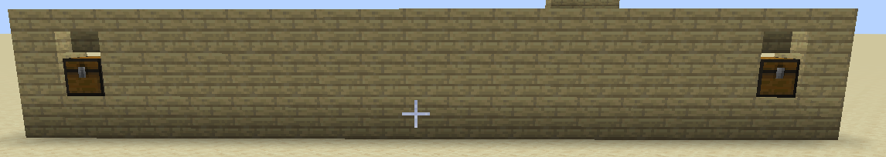
Step II
Add a chest on both ends in the shown locations, along with upside-down stairs above them

Slide 28
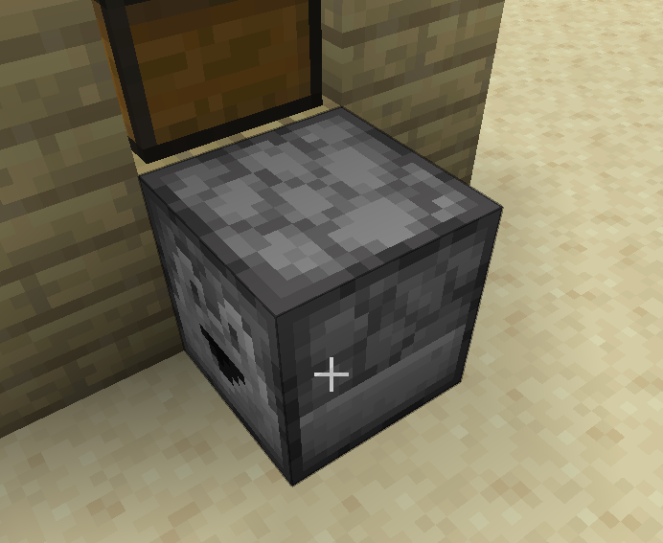
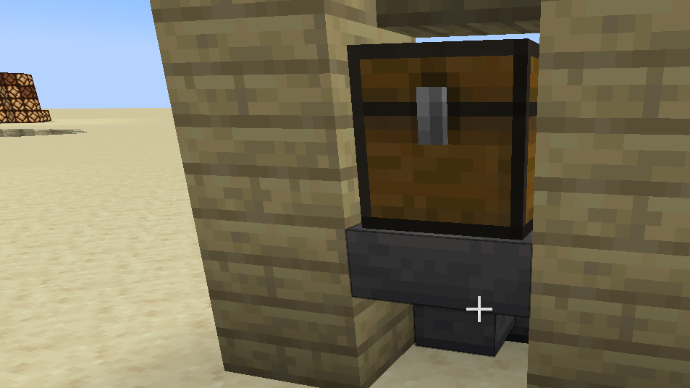
Step III
Behind the left chest place a dropper as shown and then place a hopper facing into the dropper from the front side(by right clicking the hopper with the dropper)

Slide 29
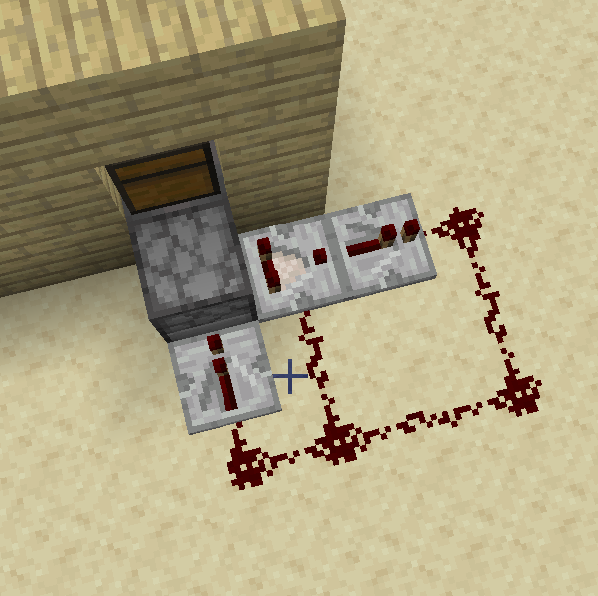
Step IV
Make the redstone circuit as shown, with the comparator and the repeater facing out from the dropper and the other repeater(on the back) facing into the dropper

Slide 30
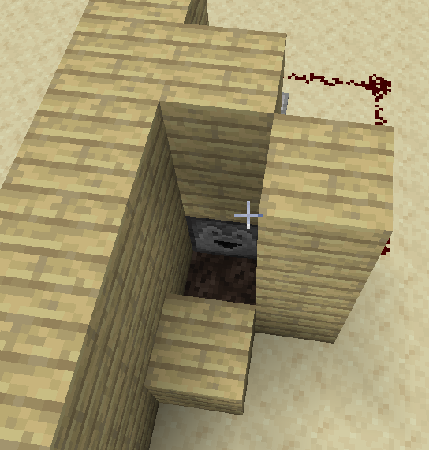
Step V
Place your building block of choice in the locations shown
Dig a hole in front of the mouth of the dropper, then fill that hole with a block of soul sand!

Slide 31
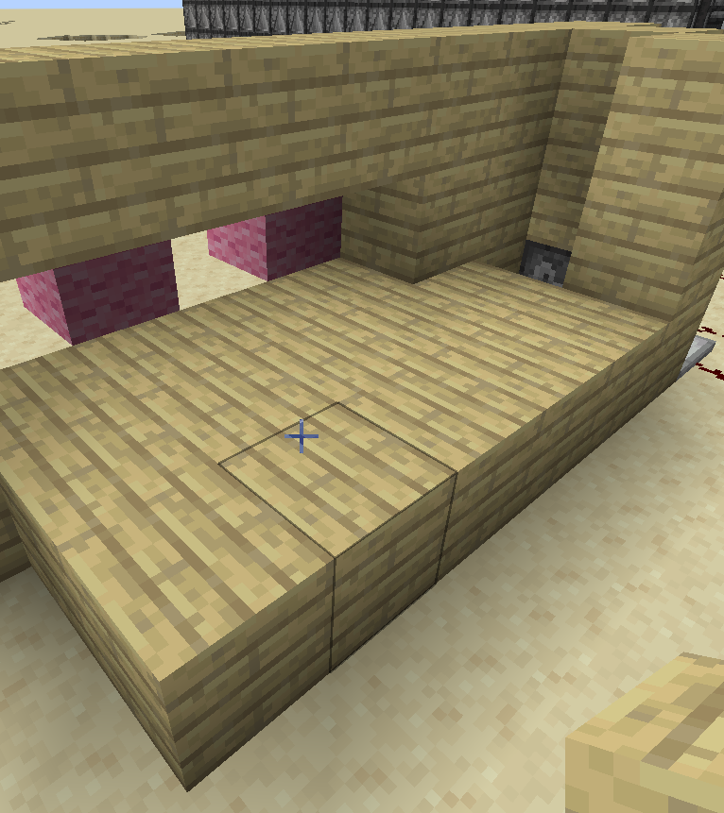
Step VI
Destroy 4 blocks in a row from the wall so it resembles the picture, then build out the platform as well.

Slide 32
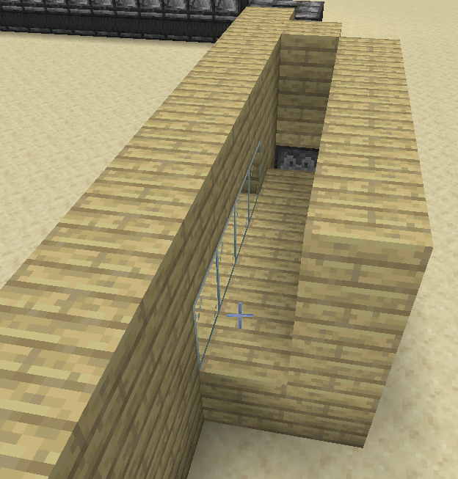
Step VII
Build up the wall to the height of the rest of the walls and put glass in the hole in the front wall you made last step.

Slide 33
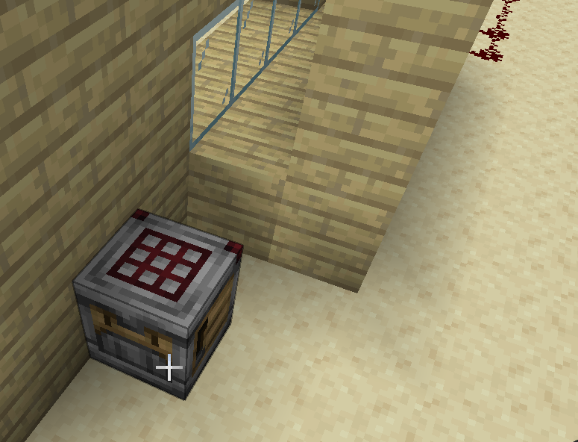
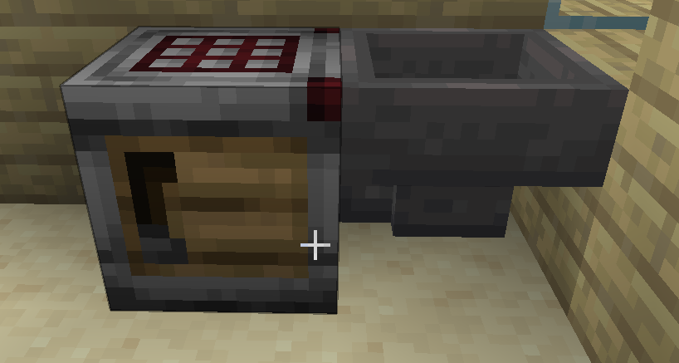
Step VIII
Add a crafter facing away from your recently built tunnel and placed 2 away from the middle.
Then go to the back of the crafter and shift-right-click it with a hopper.

Slide 34
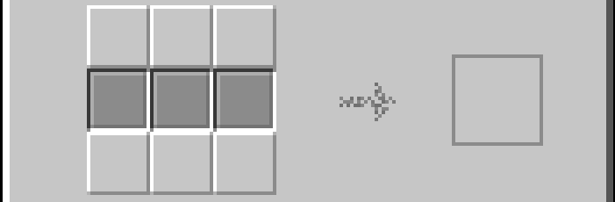
Step IX
Open the crafter and click on the top 3 and bottom 3 slots so it resembles the image

Slide 35
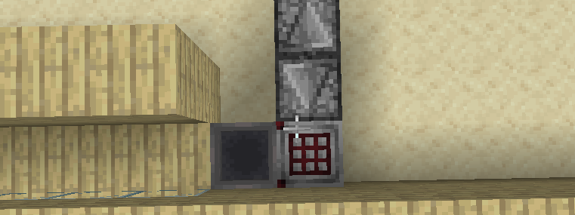
Step X
Make an observer clock as such. If done correctly the crafters red edge pieces should constantly be flashing

Slide 36
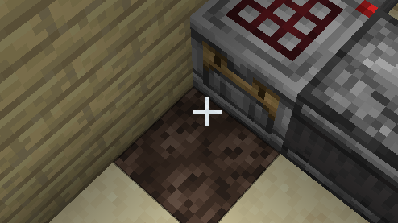
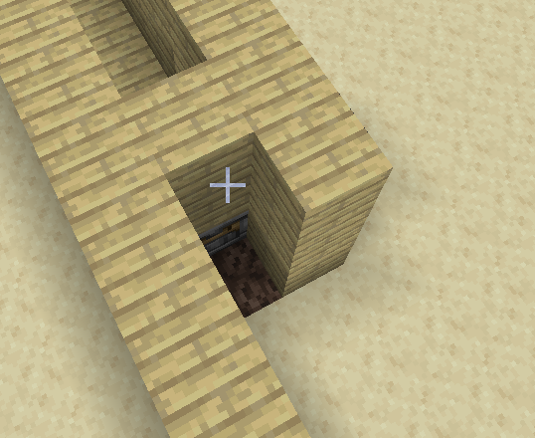
Step XI
Dig a hole in front of the crafter, then place a soul sand in that hole.
Build up the walls as shown in the image on the right

Slide 37
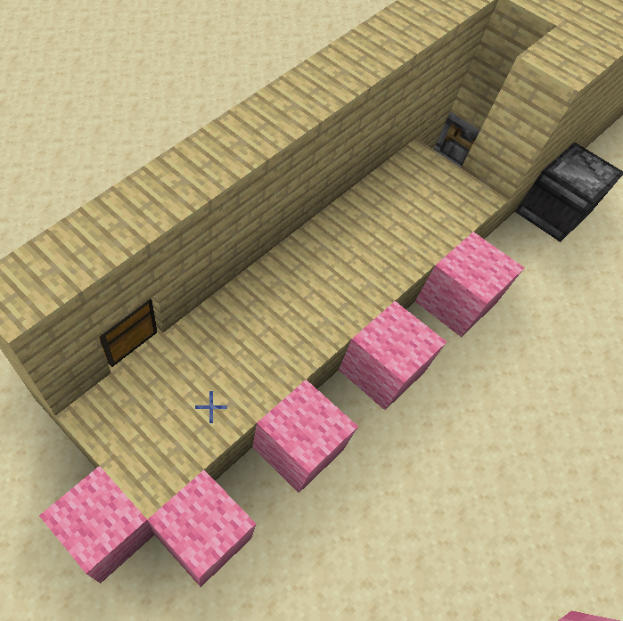
Step XII
Place down a floor, like shown

Slide 38
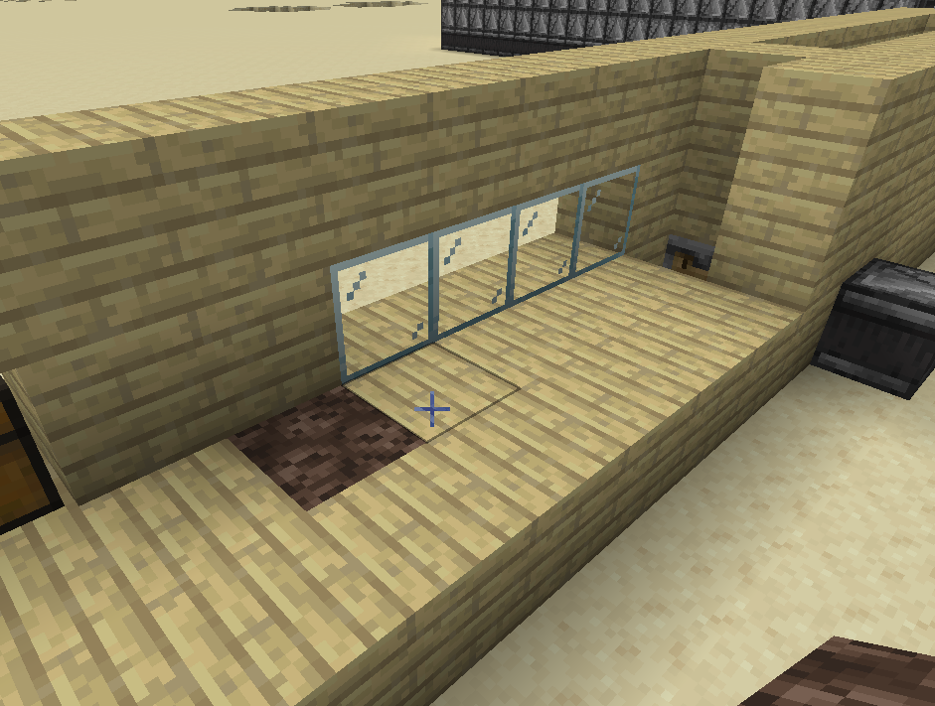
Step XIII
Replace the parts of the wall shown with glass and replace the 1 block on the ground in front of it with a block of soul sand

Slide 39
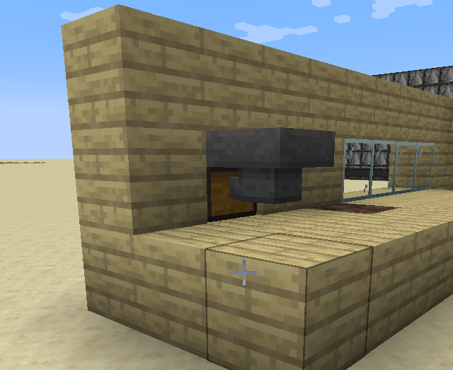

Step XIV
Shift-right-click the chest on the end with a hopper and then place your building block of choice in the spots the image shows

Slide 40

Step XV
Build up the wall with your building block of choice

Slide 41

Step XVII
Behind the last soul sand you placed, replace the block with a block of blue ice and then place a sign on the non-glass wall (you can type whatever, but nothing is needed)

Slide 42

Step XVII
Place a block of your choice above the block with the sign

Slide 43

Step XVIII
On every piece of soul sand, do the following:
Place a water bucket on top and two above the piece of soul sand
If done correctly, the top should look like what is shown above

Slide 44

Step XIX
Fill in the top of the machine where there is air (this should leave three water-filled spaces at the right side of the build)

Slide 45


Step XX
Place 3 blocks of choice above the remaining open spots
Alternative Idea: leave the top open, you’ll see jumping bread!
(although, you might want to make a glass cage to make sure the bread goes in the chest)

Slide 46

Congrats!
Put wheat in the left chest and bread will appear in the right chest
Troubleshooting:
Check to make sure everything is facing in the right direction
Make sure you placed both a water bucket directly on top and 2 above every block of soul sand
Can’t open the chests? Make sure a upside down stair block is above both chests
Wheat flowing but bread not going? Try tip #2, if nothing changes check step X and make sure the observers are facing the right direction

